Slide 1
The next Iteration
Chapter 10

Slide 2
Table of Contents
What is an Iteration?
Before the next Iteration
The next Iteration
Calculate your velocity
Implementation
Keep the overview

Slide 3
What is an Iteration?
a buildable piece of your software
completed process in a project
process
task
user story
bugs
process must be working
task
planning
testing
implementation

Slide 4
Before the next Iteration
previous Iteration
have to work
pass the test(s) (Black-box, Grey-box, White-box testing)
satisfying your customer
plan for the next Iteration

Slide 5
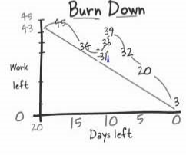
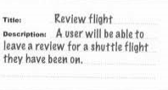

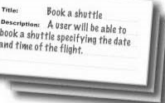
- control your work with Burn-down Graph
get the next user story
The Next Iteration
Bugs
- bugs aren‘t planned
- must be resolved
are there any additional user stories?

Slide 6
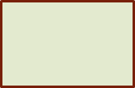


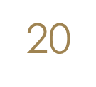
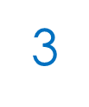
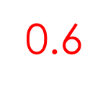


Calculate your velocity
calculate an new velocity factor from the previous iteration:
38
20
3
0.6
calculate the work days for the next Iteration:
36

Slide 7
Implementation
coding as the customer it wants
set priorities
structured programming
working & basic part in relation to the user story
implement customers wishes
talk to your customer
be carefull by reusing code
testing your code
your code must work

Slide 8
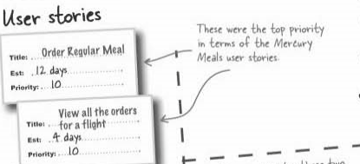
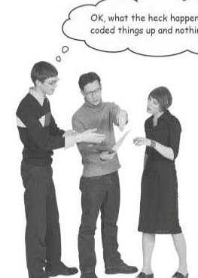

Keep the overview
user story boards
any problems?
standup-meetings
speak to your teammates
add it to burn-down graph
talk to your customer
know what the customer wants
check the customer approval
check estimated time

Slide 9
Thank you for your attention
Any Questions?

